Slide 1
Tailwind CSS

Slide 2
Reference Link
https://tailwindcss.com/docs/installation
https://www.youtube.com/watch?v=bxmDnn7lrnk&list=PL4cUxeGkcC9gpXORlEHjc5bgnIi5HEGhw
Download Git
https://github.com/iamshaunjp/tailwind-tutorial

Slide 3
VS Code Plugin
Tailwind CSS IntelliSense Plugin
( https://github.com/tailwindlabs/tailwindcss-intellisense )
Autocomplete
Intelligent suggestions for class names, as well as CSS functions and directives.
Linting
Highlights errors and potential bugs in both your CSS and your markup.
Hover Preview
See the complete CSS for a Tailwind class name by hovering over it.
Syntax Highlighting.
Provides syntax definitions so that Tailwind features are highlighted correctly.

Slide 4
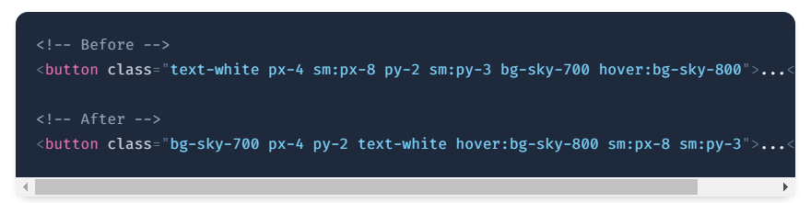
VS Code Plugin
Automatic class sorting with Prettier Plugin
( https://github.com/tailwindlabs/prettier-plugin-tailwindcss )
automatically sorts your classes following our recommended class order.
It works seamlessly with custom Tailwind configurations, and because it’s just a Prettier plugin, it works anywhere Prettier works — including every popular editor and IDE, and of course on the command line.

Slide 5
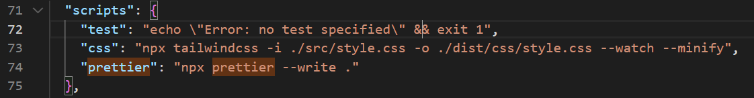
VS Code Plugin
Automatic class sorting with Prettier Plugin
Installation ( In Terminal )
npm install -D prettier prettier-plugin-tailwindcss
npx prettier --write . ( ‘ . ‘ => all file format)
npx prettier –write ‘dist/index.html’ (exact format file )
build process in package.json
"prettier": "npx prettier --write .“
Run in terminal
npm run prettier

Slide 6
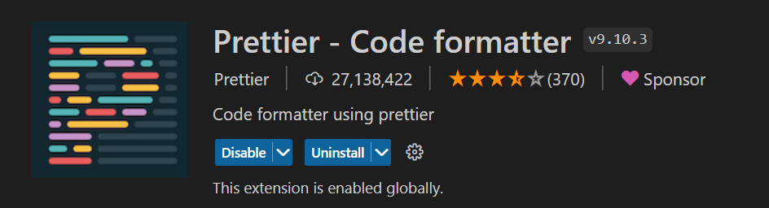
VS Code Plugin
Automatic class sorting with Prettier Plugin
Install VS Code Plugin

Slide 7
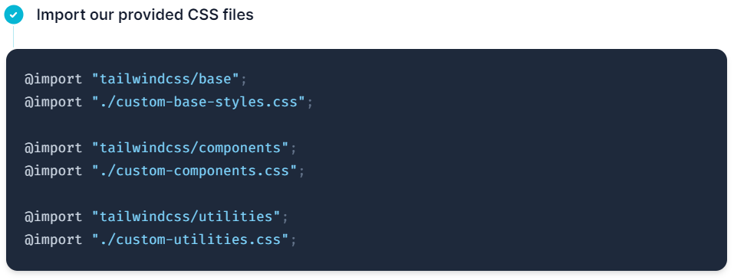
postcss-import Plugin
postcss-import Plugin
Installation ( In Terminal )
npm install -D postcss-import

Slide 8
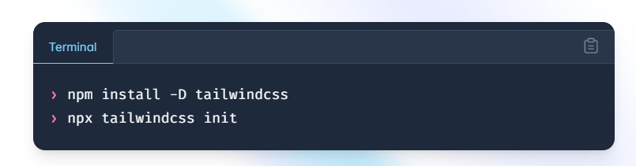
Installation
Install Tailwind CSS ( https://tailwindcss.com/docs/configuration )
npm install -D tailwindcss
npx tailwindcss init

Slide 9
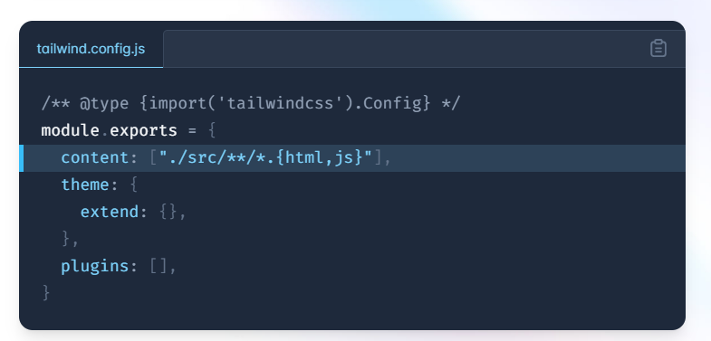
Installation
Configure your template paths ( https://tailwindcss.com/docs/configuration#content )
content: ["**/*.{html, js}", "**/**/*.{html, js}"],

Slide 10
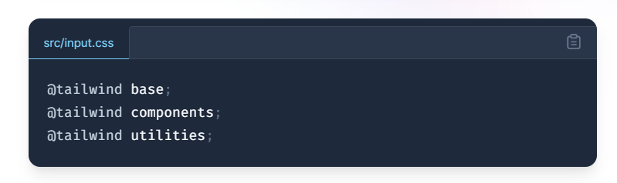
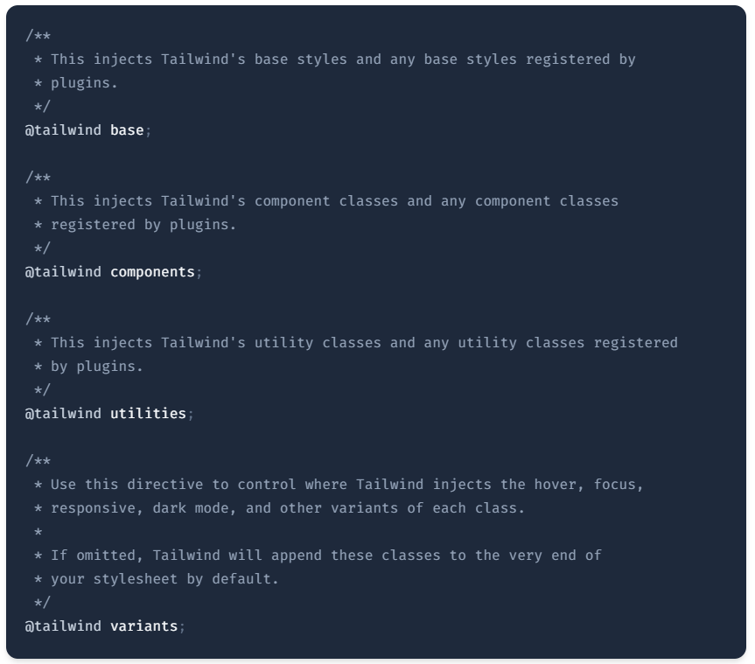
Installation
Add the Tailwind directives to your CSS
( https://tailwindcss.com/docs/functions-and-directives#tailwind )

Slide 11
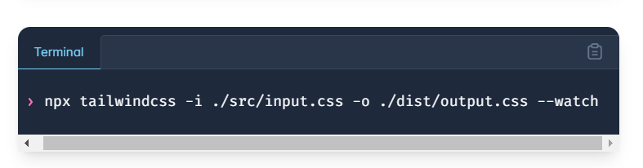
Installation
Start the Tailwind CLI build process in terminal
npx tailwindcss -i ./src/input.css -o ./dist/output.css --watch

Slide 12
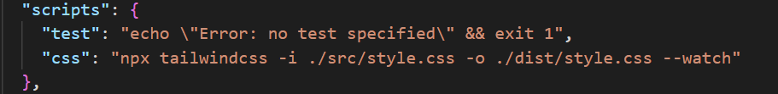
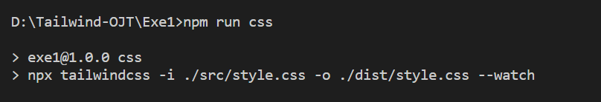
Installation
Start the Tailwind CLI build process in package.json
Run in Terminal

Slide 13
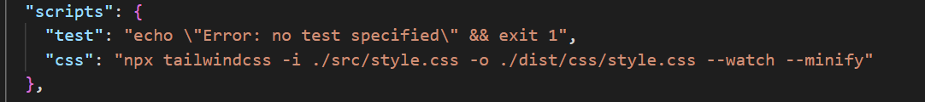
Installation
CSS Minify
npx tailwindcss -i ./src/style.css -o ./dist/css/style.css --watch --minify

Slide 14
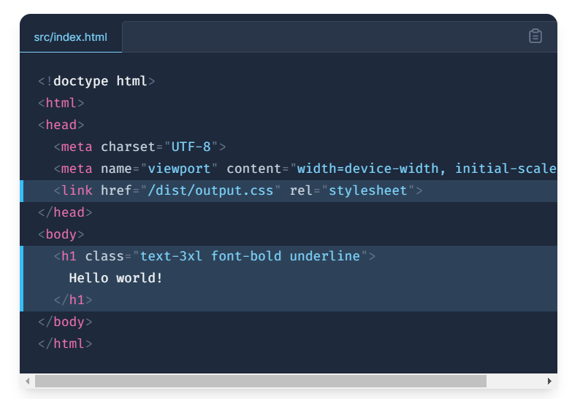
Installation
Start using Tailwind in your HTML

Slide 15
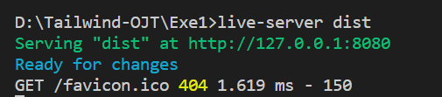
Live Server
npm install live-server
Run in Terminal
Live-server dist (output folder)

Slide 16
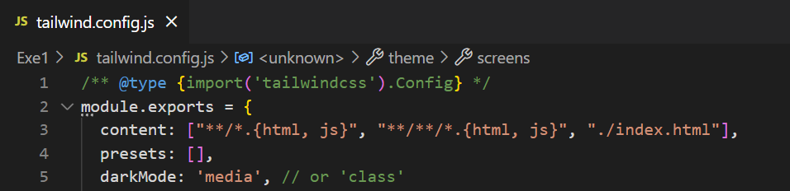
Tailwind Config
Install Tailwind CSS Full (tailwind default config file)
( https://tailwindcss.com/docs/configuration#scaffolding-the-entire-default-configuration )
npx tailwindcss init --full
tailwind.config.js
content: ["**/*.{html, js}", "**/**/*.{html, js}", "./index.html"]

Slide 17
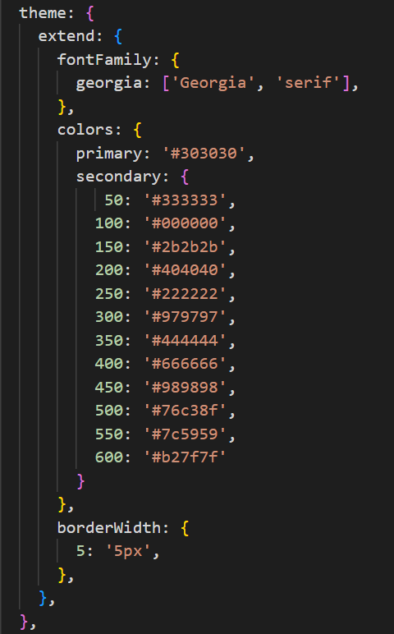
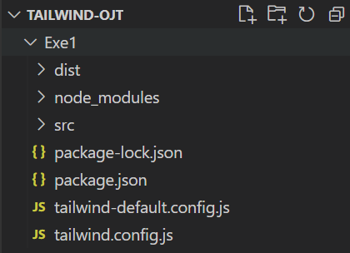
Tailwind Custom CSS Config File
Rename existing tailwind.config.js file to tailwind-default.config.js file
( https://tailwindcss.com/docs/adding-custom-styles#customizing-your-theme )
Write custom css in tailwind.config.js

Slide 18
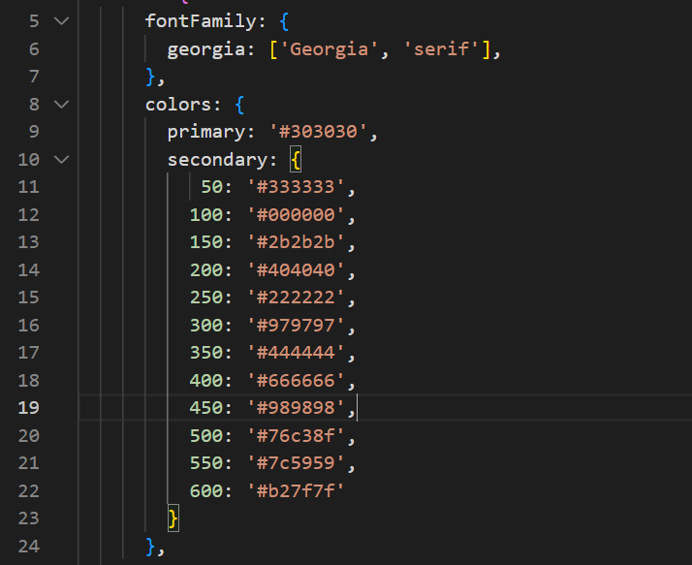
Tailwind Custom CSS Config File
Custom Css ko extend htl htae ma yay pl apyin mhr yay ml so yin default use loh ya tae css twe effect ma phyit pr.
SS htl ka atine so color ko pay htr tae color ka
lwe yin default color 1 ku mha ko use loh ma
ya tt pr .

Slide 19
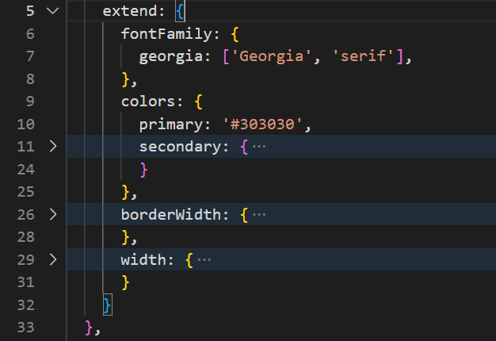
Tailwind Custom CSS Config File
Custom Css ko extend htl htae mhr htae yay ml so yin tt custom css apyin default css twe pr use loh ya pr tl.

Slide 20
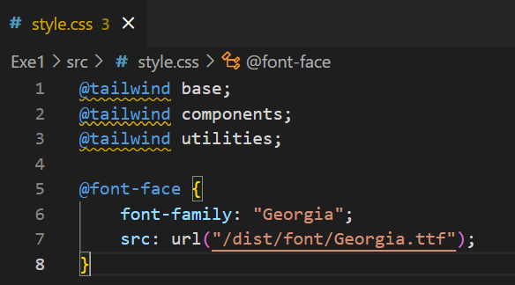
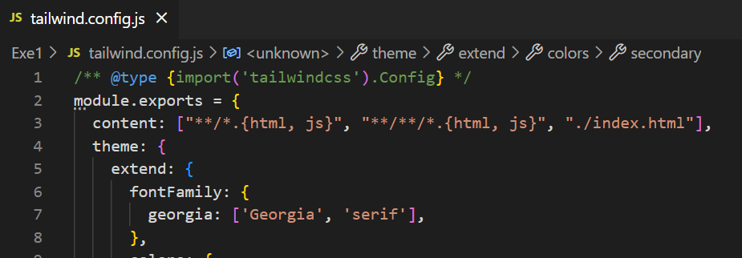
Custom FOnts
font face (or) import in style.css
Declare in config file

Slide 21


Using a different file name
In Terminal
eg., tailwind.config.js => tailwindcss-config.js
npx tailwindcss init tailwindcss-config.js
Run In Terminal
npx tailwindcss -c ./tailwindcss-config.js -i input.css -o output.css

Slide 22
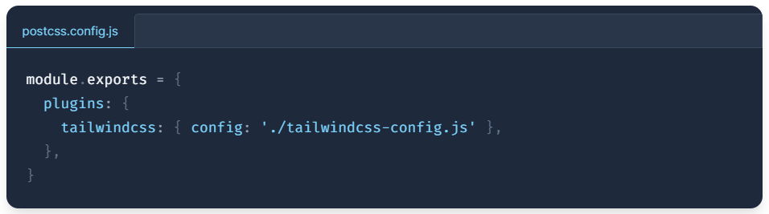
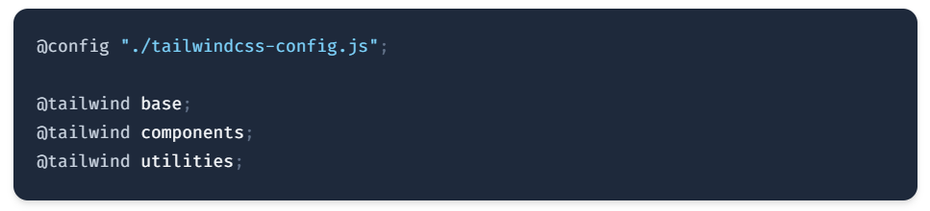
Using a different file name
In postcss.config.js
tailwindcss: { config: './tailwindcss-config.js’ },
In CSS File
@config "./tailwindcss-config.js";

Slide 23
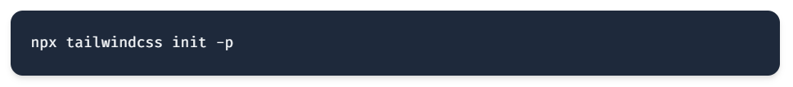
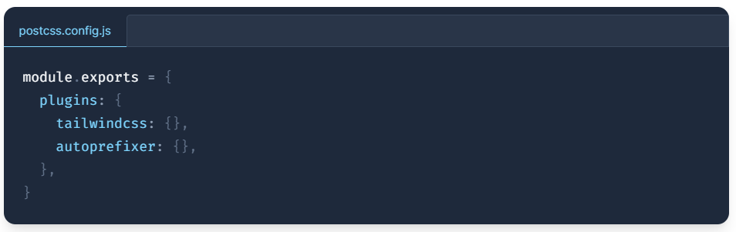
Generating a PostCSS configuration file
In Terminal
npx tailwindcss init -p

Slide 24
Responsive Classes
screens: {
sm: '640px ’, @media (min-width: 640px)
md: '768px’, @media (min-width: 768px)
lg: '1024px’, @media (min-width: 1024px)
xl: '1280px’, @media (min-width: 1280px)
'2xl': '1536px’, @media (min-width: 1536px)
}

Slide 25
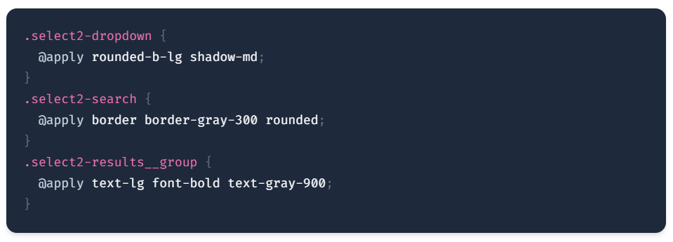
@apply Directive
Use @apply to inline any existing utility classes into your own custom CSS.
This is useful when you need to write custom CSS (like to override the styles in a third-party library) but still want to work with your design tokens and use the same syntax you’re used to using in your HTML.

Slide 26
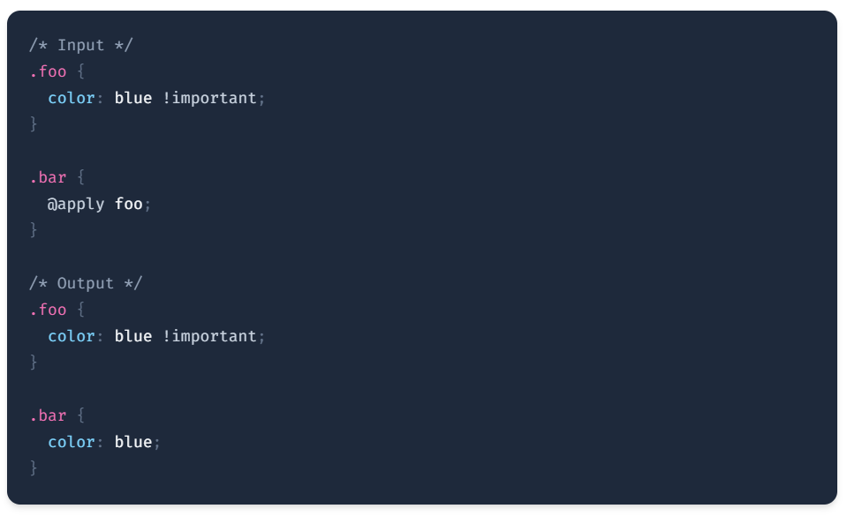
@apply Directive
Any rules inlined with @apply will have !important removed by default to avoid specificity issues:

Slide 27
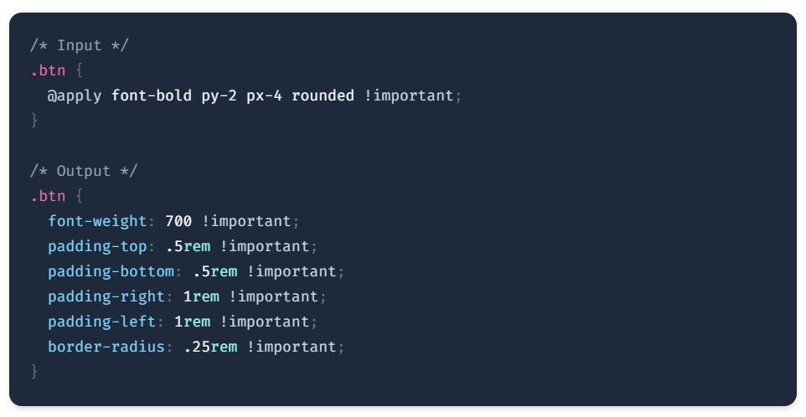
@apply Directive
If you’d like to @apply an existing class and make it !important, simply add !important to the end of the declaration:

Slide 28
Free SVG Icons
https://heroicons.com/
https://heroicons.dev/

Slide 29
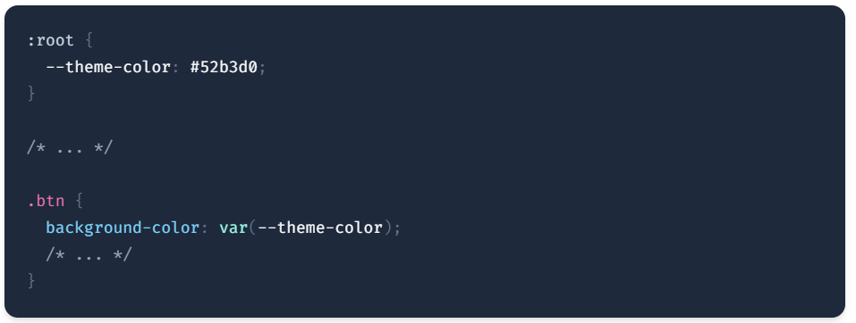
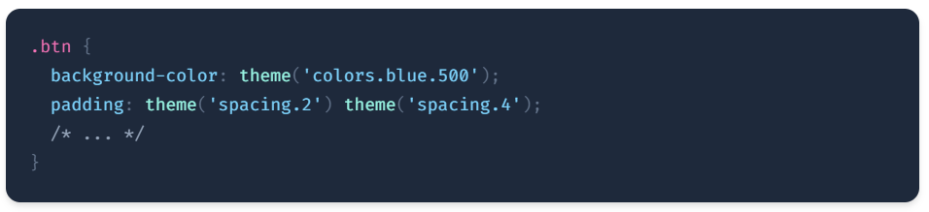
Variables
CSS variables extensively within Tailwind itself, so if you can use Tailwind, you can use native CSS variables.
You may also find that most of the things you’ve used variables for in the past can be replaced with Tailwind’s theme() function, which gives you access to all of your design tokens from your tailwind.config.js file directly in your CSS:

Slide 30
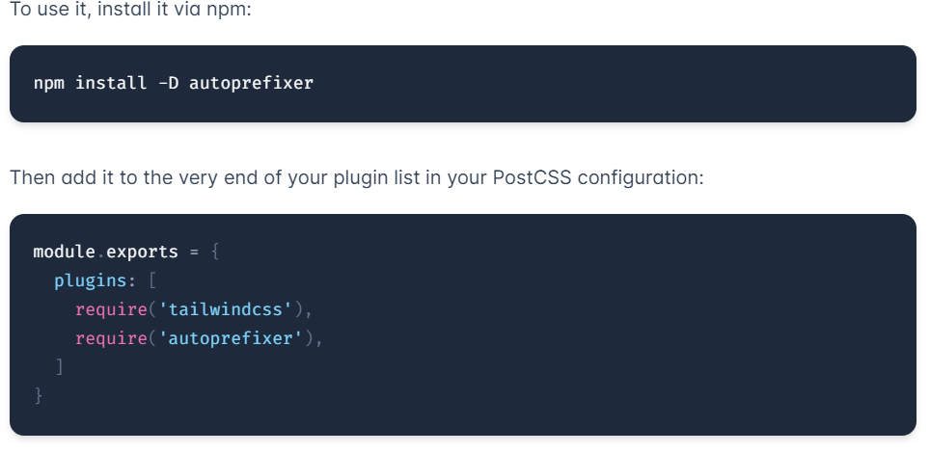
Vendor Prefixes
Many CSS properties require vendor prefixes to be understood by browsers,
for example background-clip: text needs the -webkit prefix to work in most browsers:
Autoprefixer, which is a PostCSS plugin that automatically adds any necessary vendor prefixes based on the browsers you tell it you need to support.
Auto Prefixer plugin (In Terminal)
npm install -D autoprefixer

